Slide 1
FYP 4th meeting
6 Oct 2020

Slide 2
Contents
Exploratory Data Analysis
1
Feature Engineering
2

Slide 3
DIAMANTE Student dataset
Total of 121 columns, 3770 rows
29 columns has missing values
Variable: | Number of objects: | Number of missing values:
eth_other | 90 | 3680
income_ladder | 3725 | 45
nat_lang_able | 1749 | 2021
country | 1620 | 2150
years_us | 1575 | 2195
Notes:
The data set has a total of 121 columns with 3770 rows
29 columns has missing values

Slide 4
DIAMANTE Student dataset
Variable: | Number of objects: | Number of missing values:
start_phq8_prd | 3725 | 25
start_gad_prd | 3680 | 90
time_msg | 2942 | 828
days.since.F0 | 3165 | 605
days.since.F1 | 3155 | 615
days.since.F2 | 3152 | 648
days.since.F3 | 3134 | 636

Slide 5
DIAMANTE Student dataset
Variable: | Number of objects: | Number of missing values:
days.since.F4 | 3224 | 546
days.since.M0 | 3066 | 704
days.since.M1 | 3190 | 580
days.since.M2 | 3267 | 503
days.since.M3 | 3294 | 476
days.since.T1 | 3274 | 496
days.since.T2 | 3275 | 495

Slide 6
DIAMANTE Student dataset
Variable: | Number of objects: | Number of missing values:
days.since.T3 | 3250 | 520
days.since.T4 | 3242 | 528
days.since.ind | 3199 | 571
days.since.soc | 3097 | 673
days.since.M3 | 3294 | 476
yesterday_progess | 3412 | 358
yesterday_steps | 3248 | 522

Slide 7
DIAMANTE Student dataset
Variable: | Number of objects: | Number of missing values:
today_steps | 3210 | 560
daybefyest_steps | 3196 | 574
step_change_yest | 3055 | 715
step_change_today | 3095 | 675
Out of these 29 variables, 4 variables eth_other, nat_lang_able, country, years_us has more than 2000 missing values

Slide 8
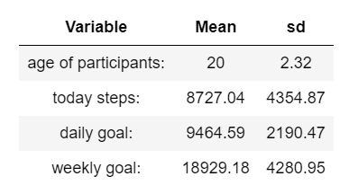
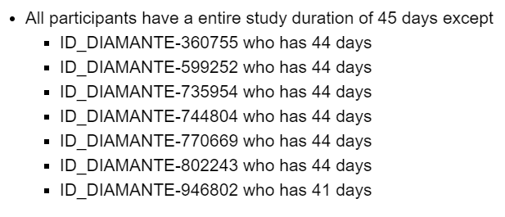
Some descriptive statistics (n = 84)
Notes:
There is variable called study_day which tracks the number of days of each participants for their entire duration of the study
7 participants do not have full 45 days of study

Slide 9
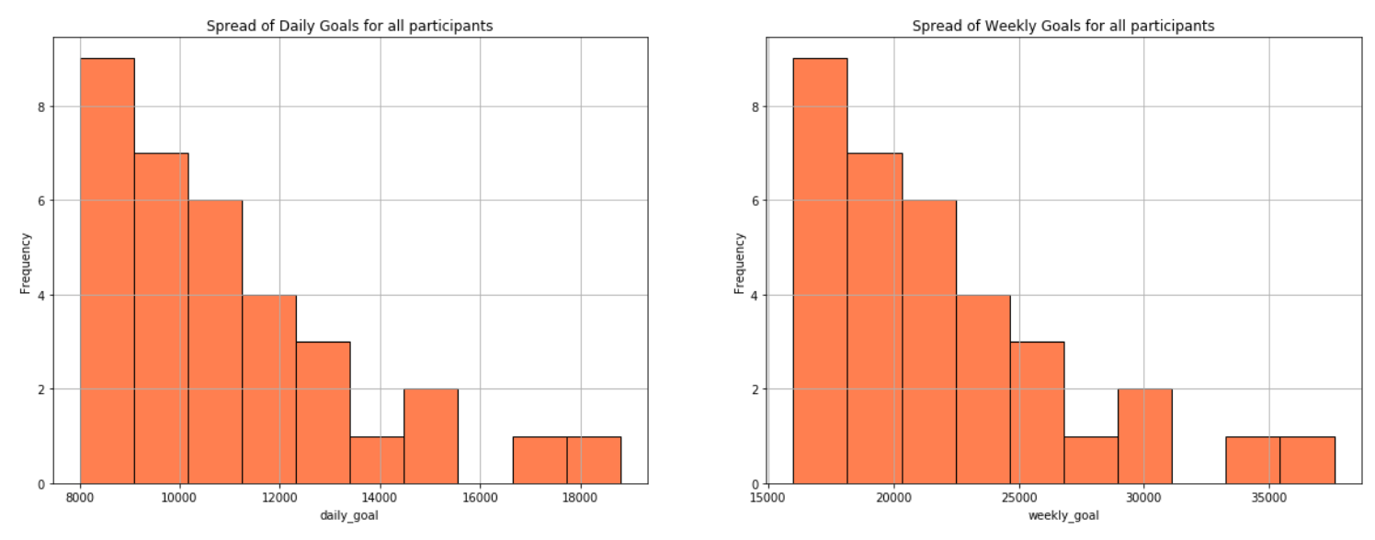
Majority of participants indicated their daily steps goal of 8000 to 10000
Majority of participants indicated their weekly steps goal of 15000 to 22500
Notes:
Distribution of daily goals has mean of 9465 steps
Distribution of weekly goals has a mean of 18929 steps

Slide 10
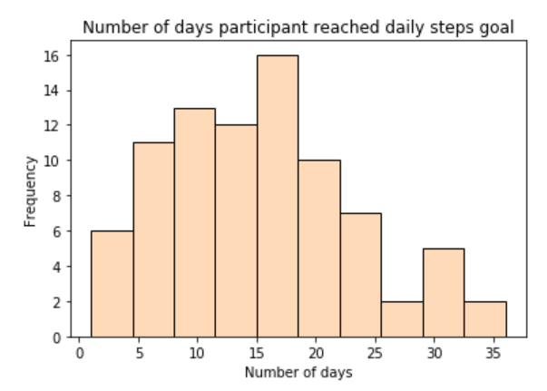
Distribution of variables:
Out of the whole duration of 45 days for each participants, most participants reached their daily steps goals for about 15 to 19 days
No participants hit their daily steps goals for all 45 days
Notes:
Here, i replaced the NA’s in today_steps with zeros (because later on, if i remove NA’s some participants wont have data for some days
This is a distribution plot of the number of days a participant reached their daily steps goal

Slide 11
Some barcharts for different variables

Slide 12
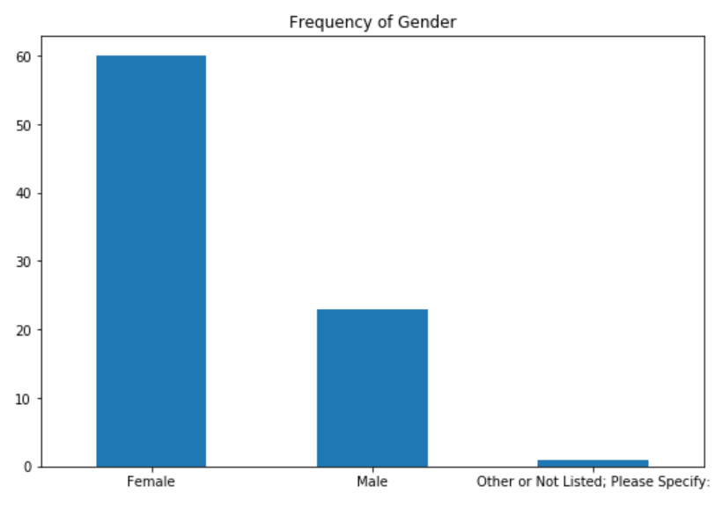
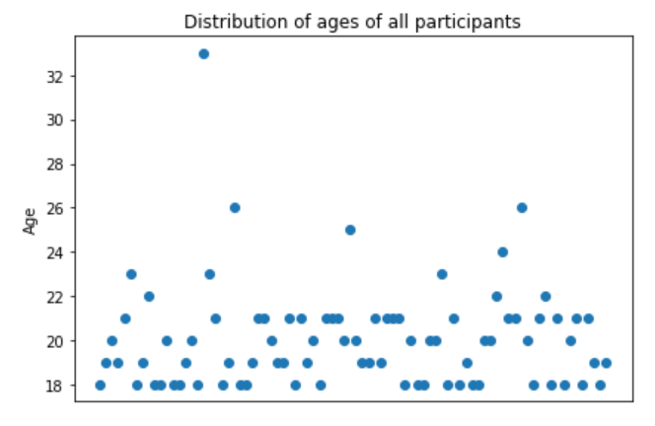
Majority of the participants are female
Most of the participants age range from 18 to 21
Notes:
60 females, 23 males, 1 other

Slide 13
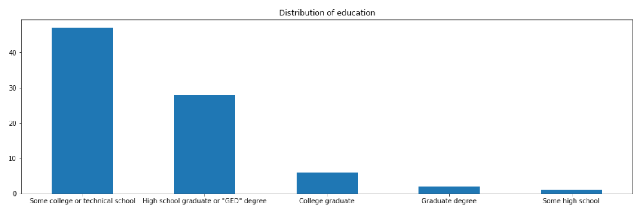
Majority of the participants are from college or technical school and are high school graduate or has a “GED” degree
Notes:
Some college or technical school 47
High school graduate or "GED" degree 28
College graduate 6
Graduate degree 2
Some high school 1

Slide 14
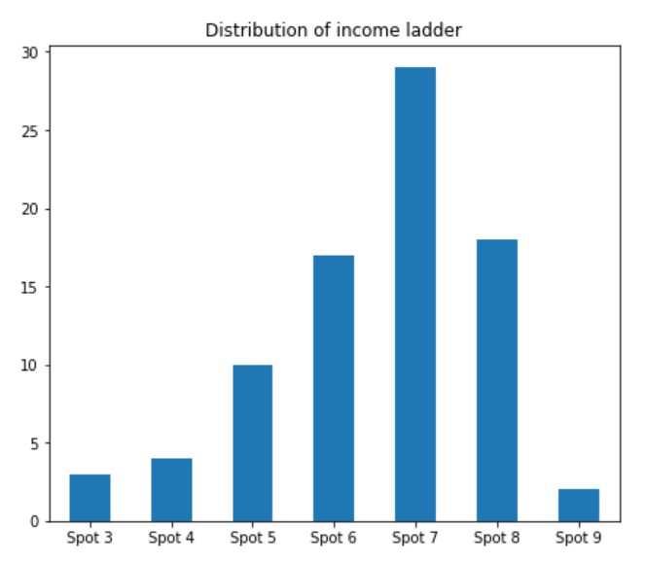
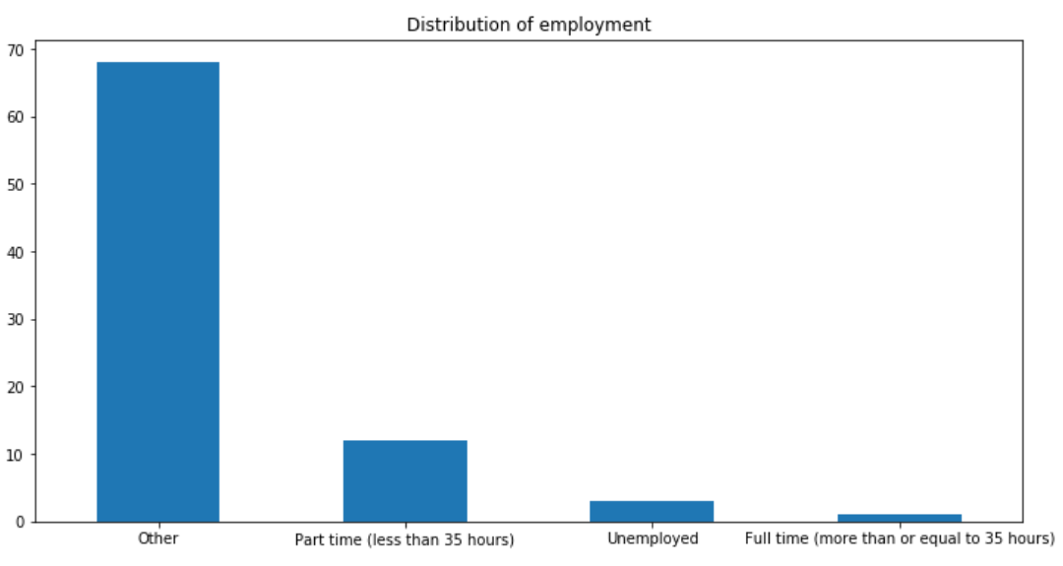
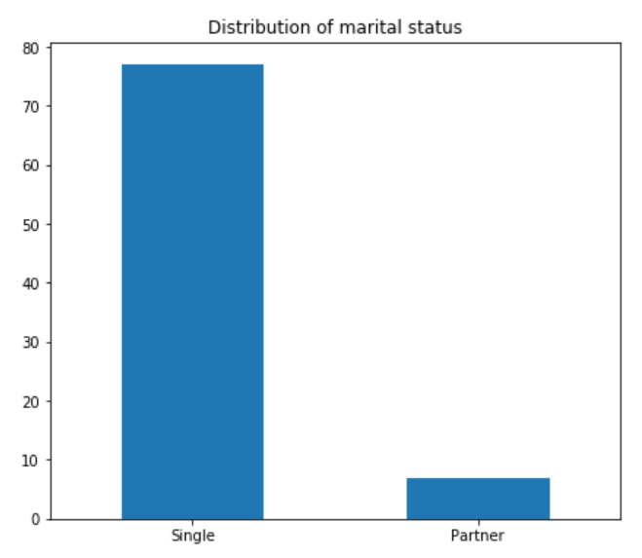
with 10 being the most well off for income ladder
Notes:
Majority of the students are doing well in term of income ladder in their families
77 of them are single whereas 7 of them have partners
Majority of the students 68 should be considered as under other where it is probably students
12 of them are working part time (less than 35 hours)
1 of them are working full time

Slide 15
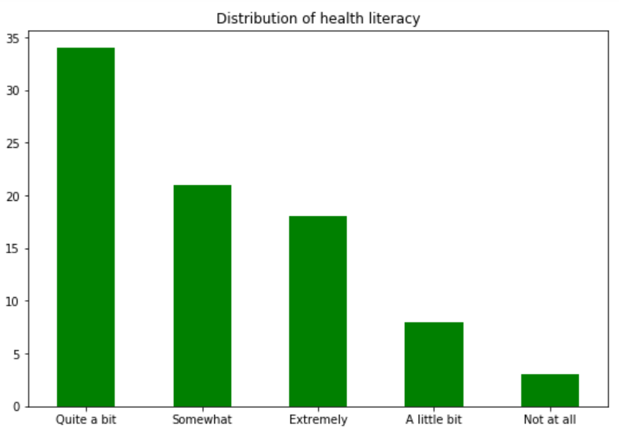
Most participants are quite comfortable with filling medical forms by themselves
Notes:
Distribution of health literacy:
Quite a bit: 34. Somewhat: 21. Extremely: 18. A little bit: 8. Not at al: 3

Slide 16
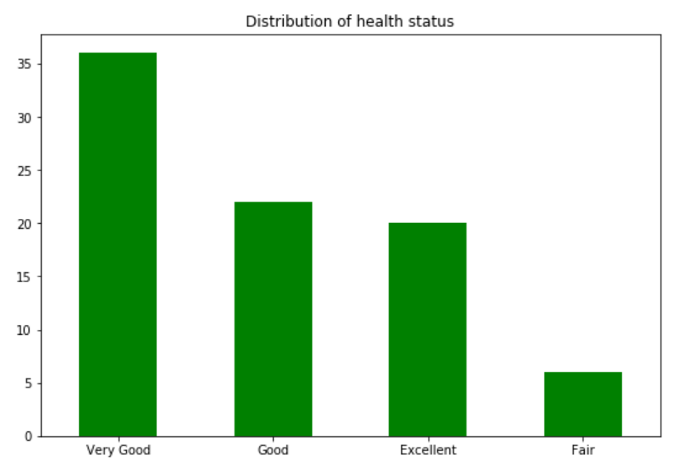
Majority of participants rate their health status as good
Notes:
Majority of the participants are in good health
Very Good 36
Good 22
Excellent 20
Fair 6

Slide 17
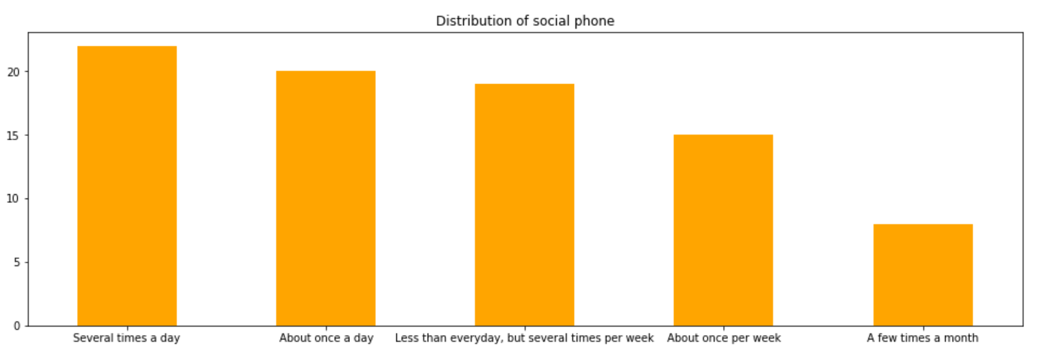
Distribution of participants talking on their phone with family, friends, or neighbors is rather similar with only a minority talk only a few times a month
Notes:
Several times a day 22
About once a day 20
Less than everyday, but several times per week 19
About once per week 15
A few times a month 8

Slide 18
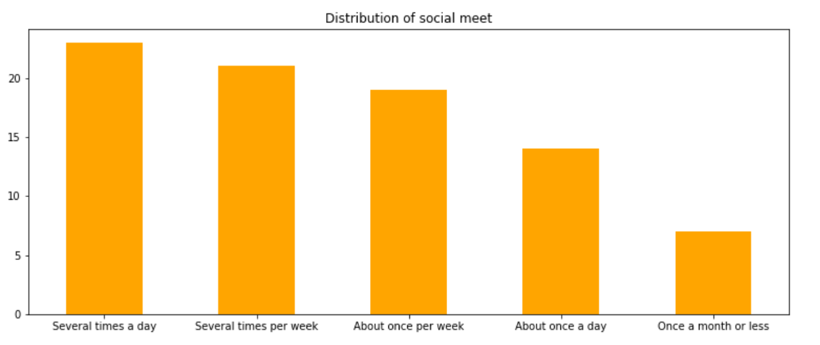
Majority of participants meet together with their friends or relatives at least once a week. Only a minority meet once a month or less
Notes:
Several times a day 23
Several times per week 21
About once per week 19
About once a day 14
Once a month or less 7

Slide 19
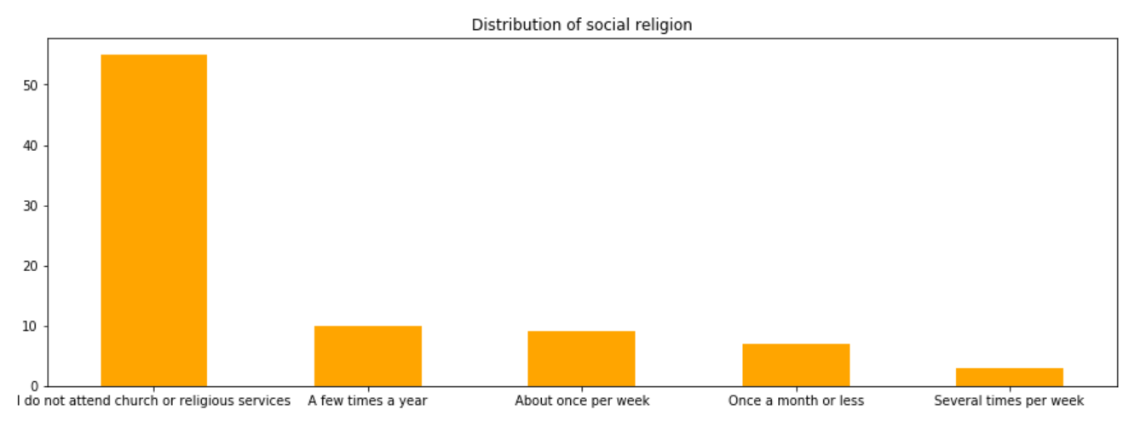
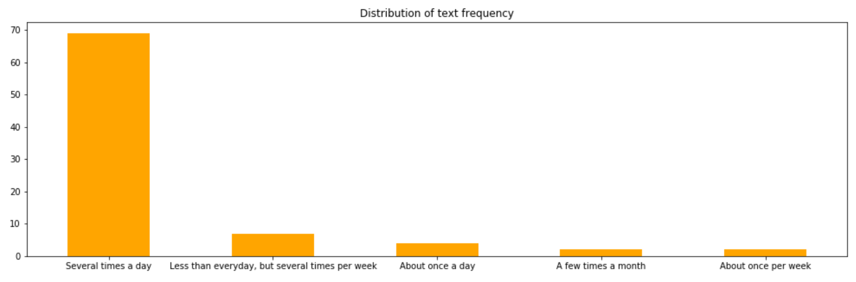
Majority of participants do not attend religious services and text at least several times a day
Notes:
I do not attend church or religious services 55
A few times a year 10
About once per week 9
Once a month or less 7
Several times per week 3
Several times a day 69
Less than everyday, but several times per week 7
About once a day 4
A few times a month 2
About once per week 2

Slide 20
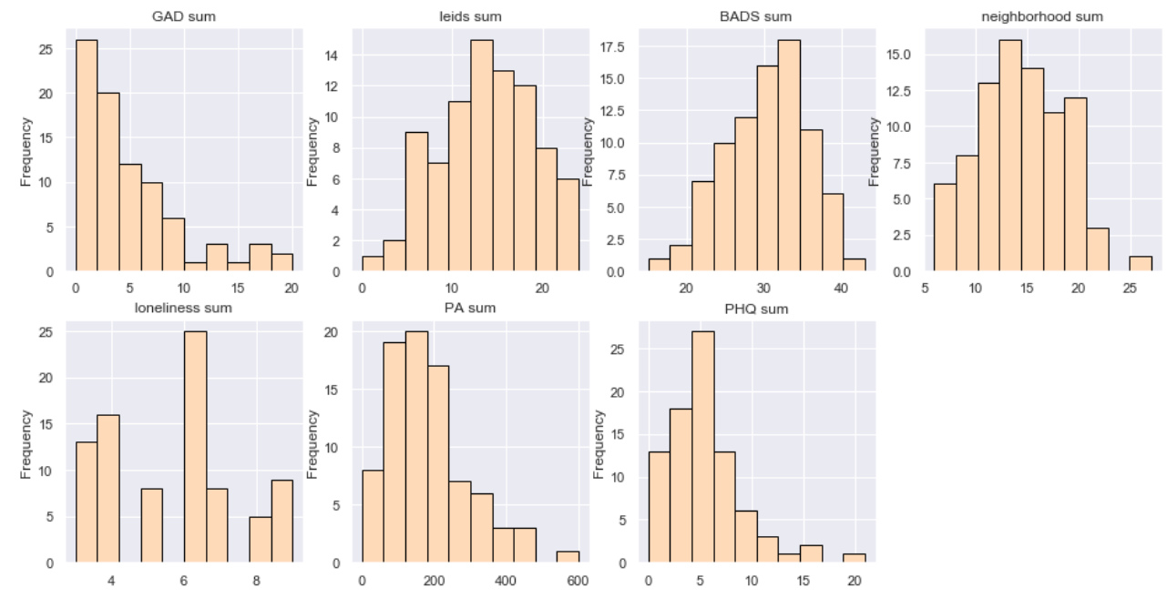
Notes:
GAD_sum, leids_sum, BADS_sum, neighborhood_sum, loneliness_sum for participants (i missed out phq sum)
where
phq_sum is a useful depression measure for population-based studies and a cutpoint of more than or equal to 10 can be used for defining current depression
BADS_sum is a behavioral activation scale
LEIDS_sum is rumination scores (a deep or considered thought about something)
GAD_sum is generalized anxiety disorder score
PA_sum is physical activity (i presume?)
neighborhood sum (?)

Slide 21
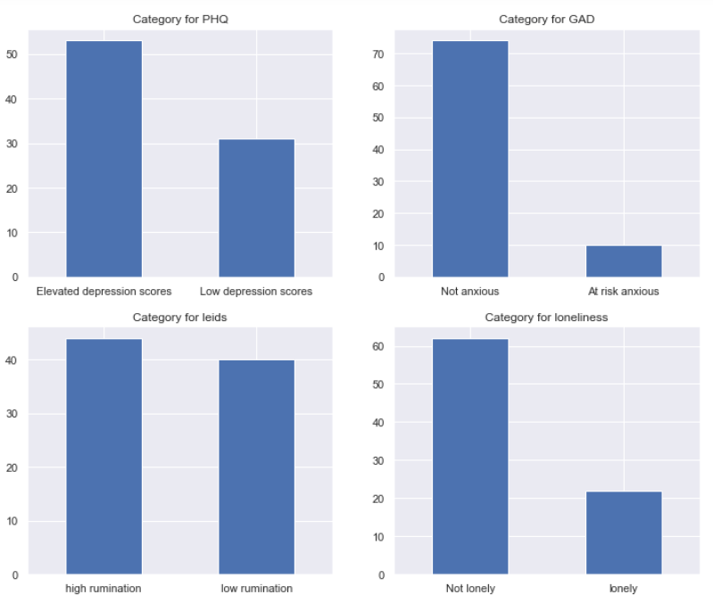
Majority of the students have an elevated depression score, do not have generalized anxiety disorder and are not lonely
There is roughly equal number of students who has high and low rumination
Notes:
Majority of the students 53 has an elevated depression score while 31 has low depression scores
Majority of the students 74 are not anxious where 10 of them are t risk anxious
Majority of the students 62 are not lonely whereas 22 of them are lonely

Slide 22
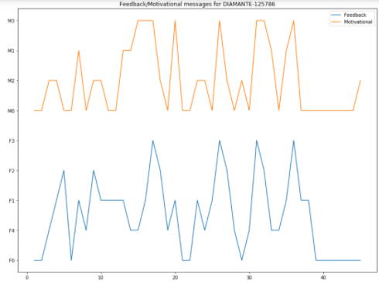
Feedback/motivational messages for each individual participants
Feedback and motivational messages for participant ID 125786
daily step counts for the entire 45 days duration
‹#›

Slide 23
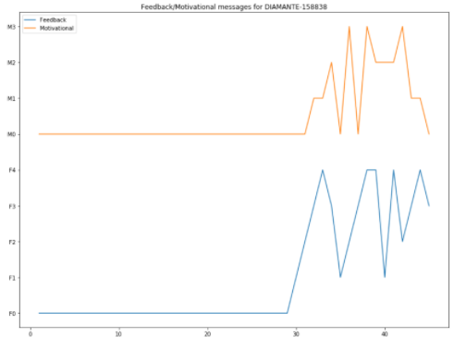
Feedback/motivational messages for each individual participants
Feedback and motivational messages for participant ID 158838
The first close to 30 days this participant does not receive any feedback or motivational messages
Does this mean the first part is a control?
‹#›
Notes:
For example for this participant, the first 30 days he did not receive any message at all
How to differentiate between 3 types of intervention (adaptive, uniform and control)

Slide 24
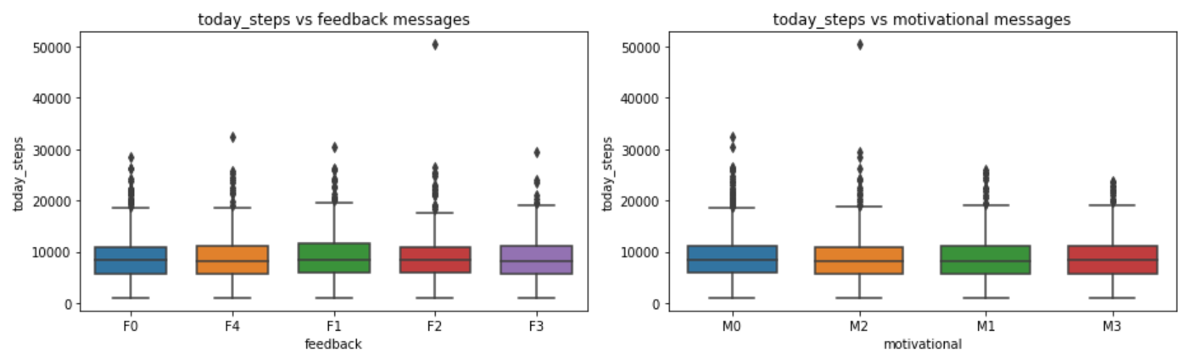
Boxplots of today_steps vs feedback and motivational
For these results, I removed rows with NA’s for today_steps
Notes:
For this, i removed rows with NA’s for today_steps as having 0’s inside will affect my result

Slide 25
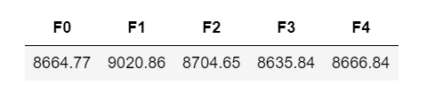
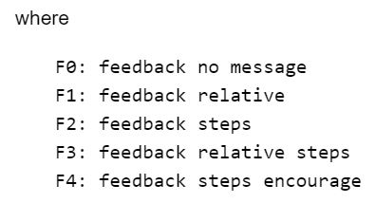
Table of average steps for each feedback messages for all participants
For these results, I removed rows with NA’s for today_steps

Slide 26

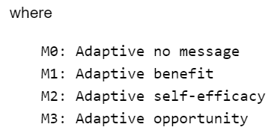
Table of average steps for each motivational messages for all participants
For these results, I removed rows with NA’s for today_steps

Slide 27
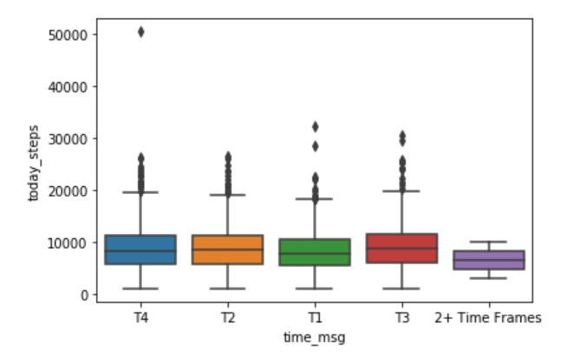

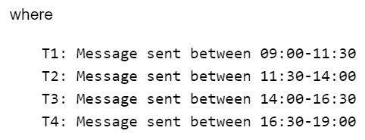
Boxplot and table of average steps for each
message timing for all participants
For these results, I removed rows with NA’s for today_steps

Slide 28
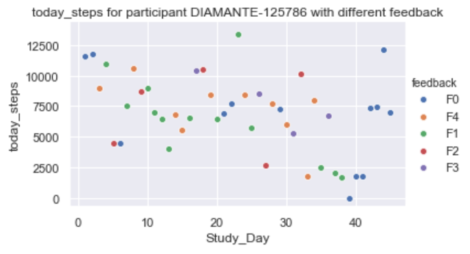
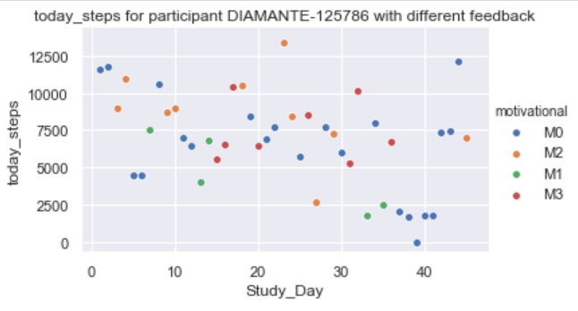
today steps vs study day for different
feedback/motivational messages
Notes:
Plot of today steps vs study days with different motivation and feedback messages for participant with ID DIAMANTE 125786
No visible trend here
Need to think of a better way to plot this because I have 84 plots for each participants

Slide 29
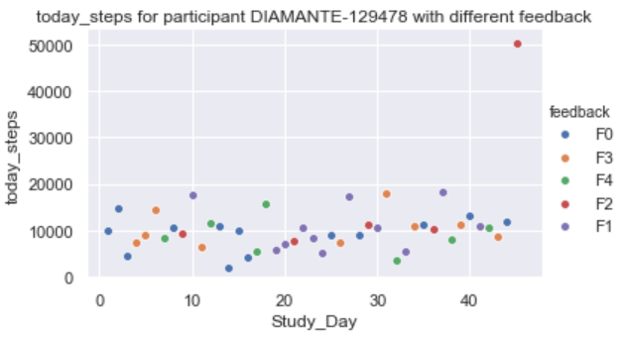
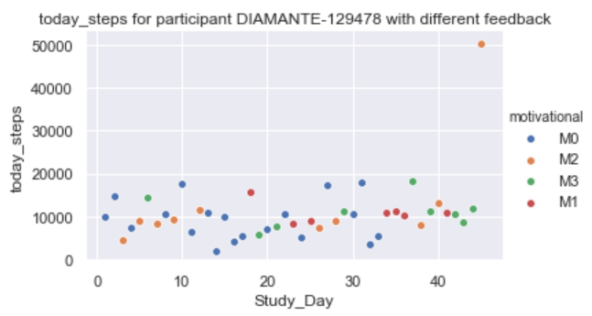
today steps vs study day for different
feedback/motivational messages
Notes:
Plot of today steps vs study days with different motivation and feedback messages for participant with ID DIAMANTE 125478
yaxis scale for today_steps is different from the previous participant
This participant generally walks more than previous participant
All around 10k steps range

Slide 30
Feature engineering

Slide 31
Feature Engineering
Imputation
Numerical Imputation
Drop rows or columns with missing values
Or can use an threshold for dropping (for e.g. drop rows which have mean missing values with higher than a certain threshold)
Preferred choice over just dropping as it preserves data size
Replace NA’s with 0’s as long as it make sense
Could replace NA’s with mean of columns, median or most frequent value
Notes:
Categorical Imputation: Replacing the missing values with the maximum occurred value in a column is a good option for handling categorical columns

Slide 32
Feature Engineering
Log transformation
One-hot encoding
Allows skewed data to become approximately normal and makes statistical analysis more valid
Converts categorical data into multiple binary columns of 1’s or 0’s
Notes:
Log transformation also decreases the effect of the outliers due to the normalization of magnitude differences and the model become more robust

Slide 33
Feature Engineering
Normalization
Standardization
Scales all values in a fixed range between 0 and 1
Transforms data to have mean 0 and standard deviation 1

Slide 34
Feature Engineering
Binning
Group continuous numerical numbers into smaller number of bins
Can be used to reduce the minor observation errors

Slide 35
Thank you!

